Slide 1
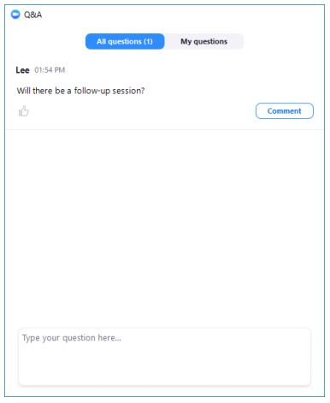
Postdoc Listening Sessions: Housekeeping
The listening session will include opening remarks, introductions, and remarks from invited speakers, followed by a facilitated discussion for the remainder of the session, inviting all attendees to share input
Attendees will be muted at the beginning of the session
To share your input: please use the Q&A function to share your comments with the facilitators
Facilitators will call on specific attendees to speak. If called upon, the host will enable you to unmute. Please state your name before sharing input
If you prefer to contribute anonymously, please share your comment using the anonymous option, and a facilitator will read it without attribution
Please communicate through the Q&A function if you are experiencing technical difficulties
Time: we will be keeping time; each commenter will have 1-2 minutes to share

Slide 2
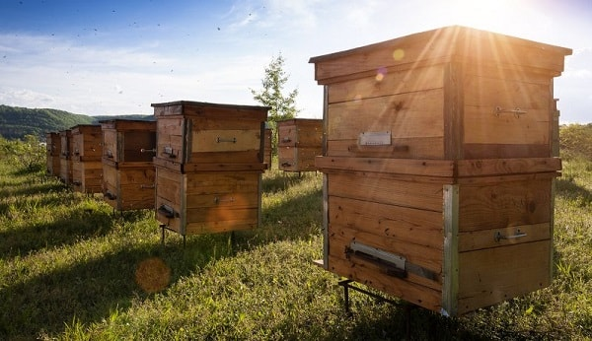
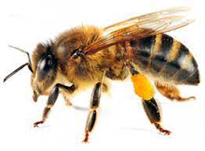
Role of Postdocs in Academic Science: The Tempting Promise
Postdocs as “worker bees” of academia that would one day be rewarded for their toils with hives of their own
- Paula Stephan, Economist, Georgia State University

Slide 3
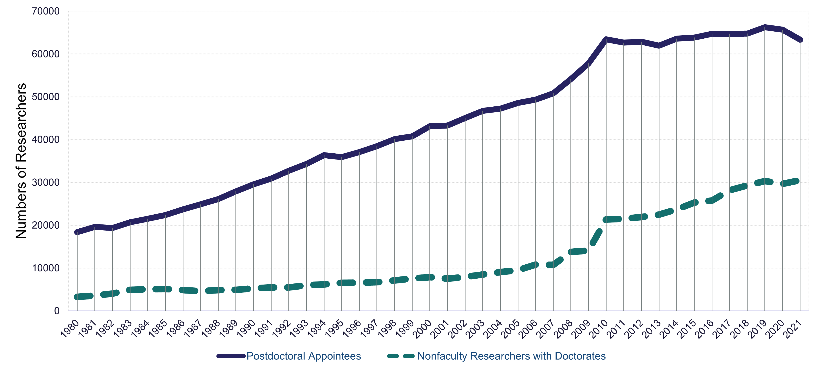
Postdoc numbers steadily increased after 1980, stayed relatively flat for the last decade, and declined since 2020
NSF Statistics: U.S. Researchers by Position Over Time
https://ncses.nsf.gov/pubs/nsf23312

Slide 4
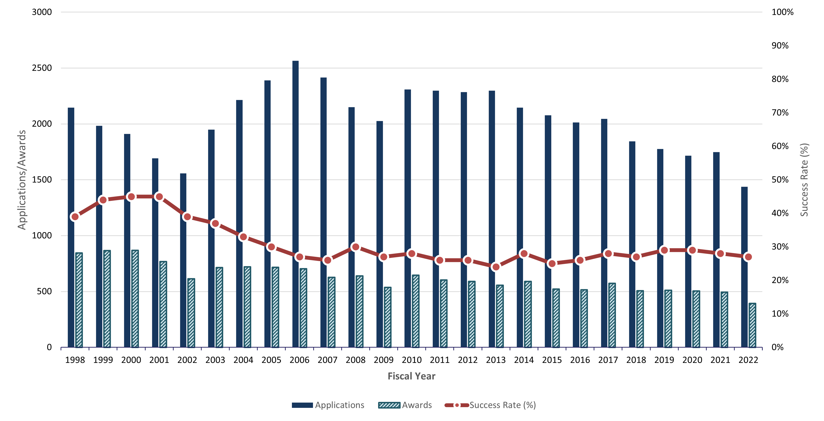
NIH postdoc fellowship applications and awards are decreasing
Kirschstein-NRSA Post-Doctoral Fellowships (F32s): Competing Applications, Awards and Success Rates
Data for this report are available at NIH Data Book - https://report.nih.gov/nihdatabook/report/62

Slide 5
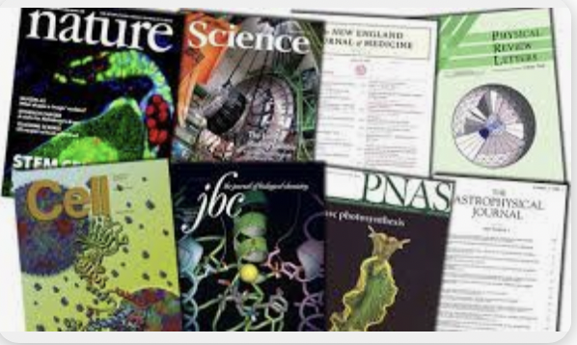
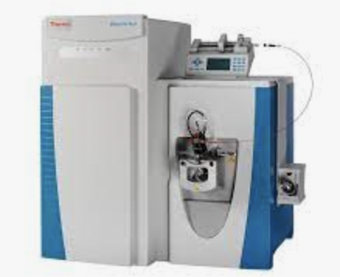
Forces Driving Decline: Role, Duration, Structure, and Value of the Postdoc
Limited opportunities
in academia
Lengthening time to publish
QUALITY
OF LIFE
New opportunities in Pharma/Biotech
Expanding research expectations
Increasing expectations: Work/life balance Cost of living

