Slide 1
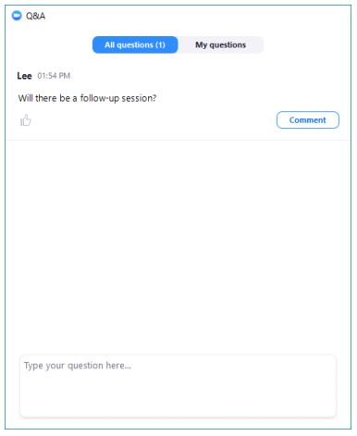
Postdoc Listening Sessions: Housekeeping
The listening session will include opening remarks, introductions, and remarks from invited speakers, followed by a facilitated discussion for the remainder of the session, inviting all attendees to share input
Attendees will be muted at the beginning of the session
To share your input: please use the Q&A function to share your comments with the facilitators
Facilitators will call on specific attendees to speak. If called upon, the host will enable you to unmute. Please state your name before sharing input
If you prefer to contribute anonymously, please share your comment using the anonymous option, and a facilitator will read it without attribution
Please communicate through the Q&A function if you are experiencing technical difficulties
Time: we will be keeping time; each commenter will have 1-2 minutes to share

Slide 2
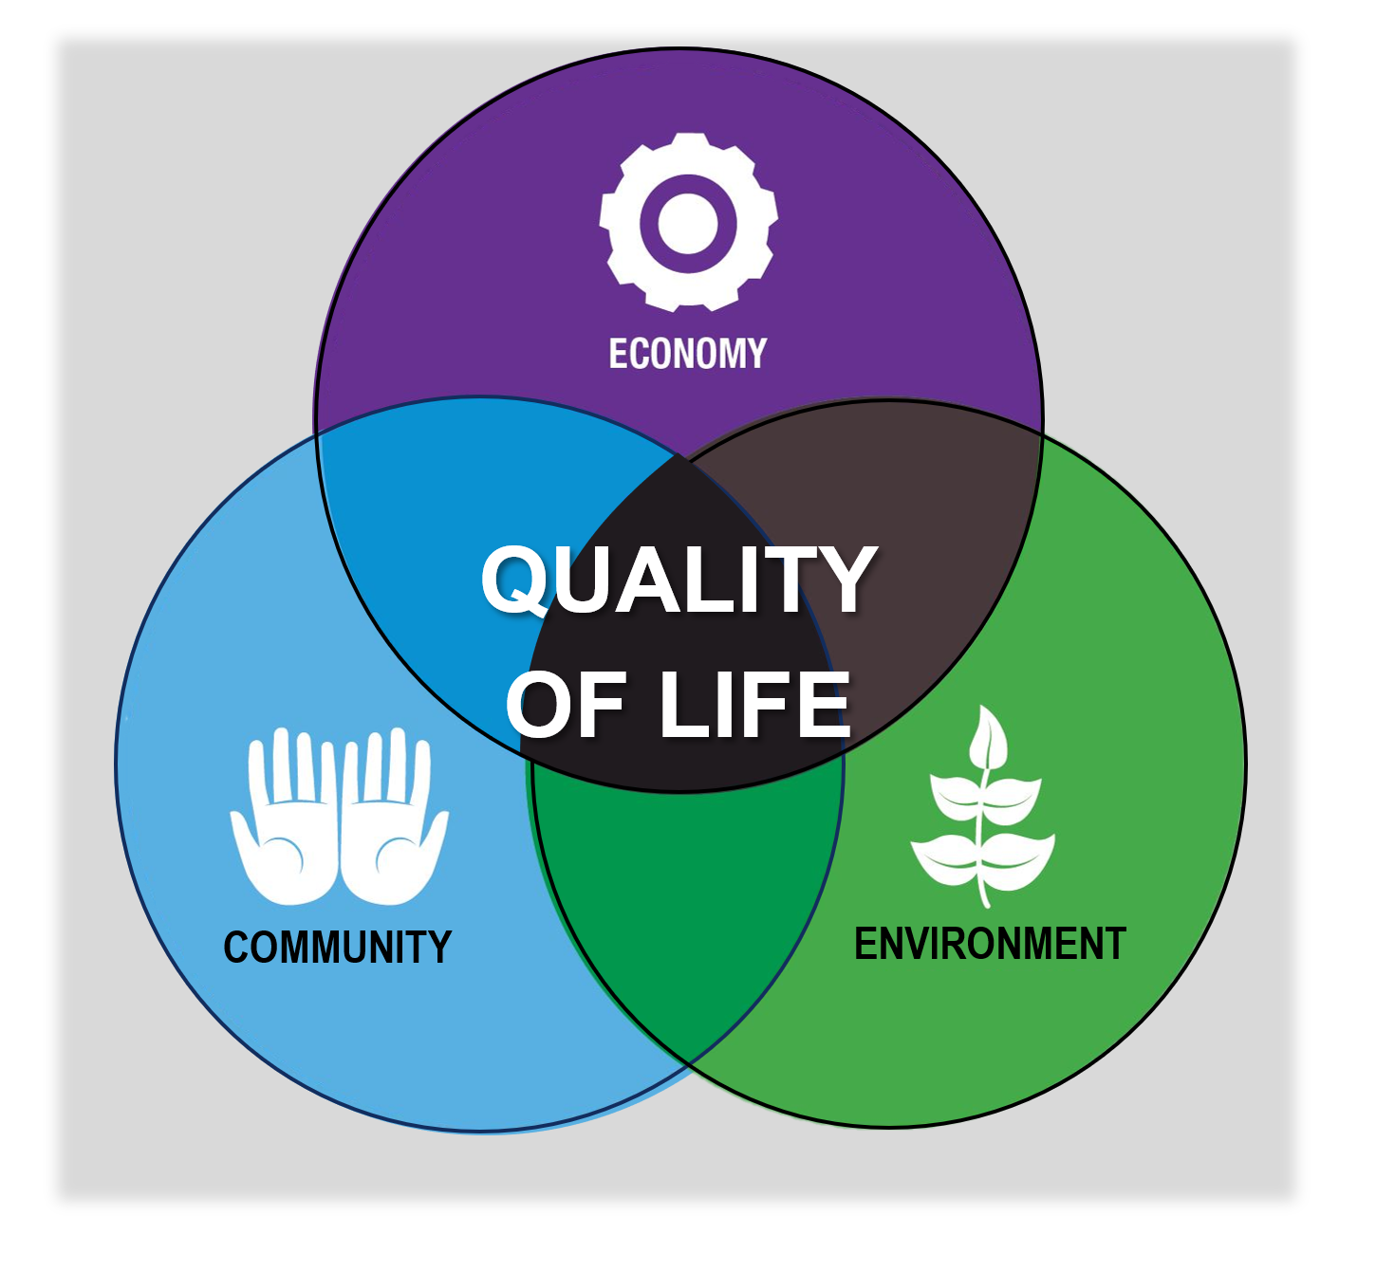
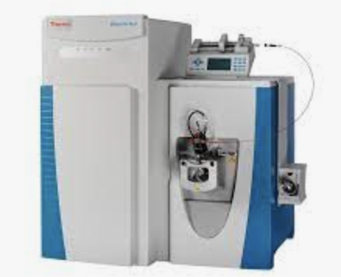
Forces driving decline in postdocs are multifactorial and complex
Limited opportunities in academia
Lengthening time to publish
Increasing expectations: Work/life balance Cost of living
Expanding research expectations
New opportunities in Pharma/Biotech

Slide 3
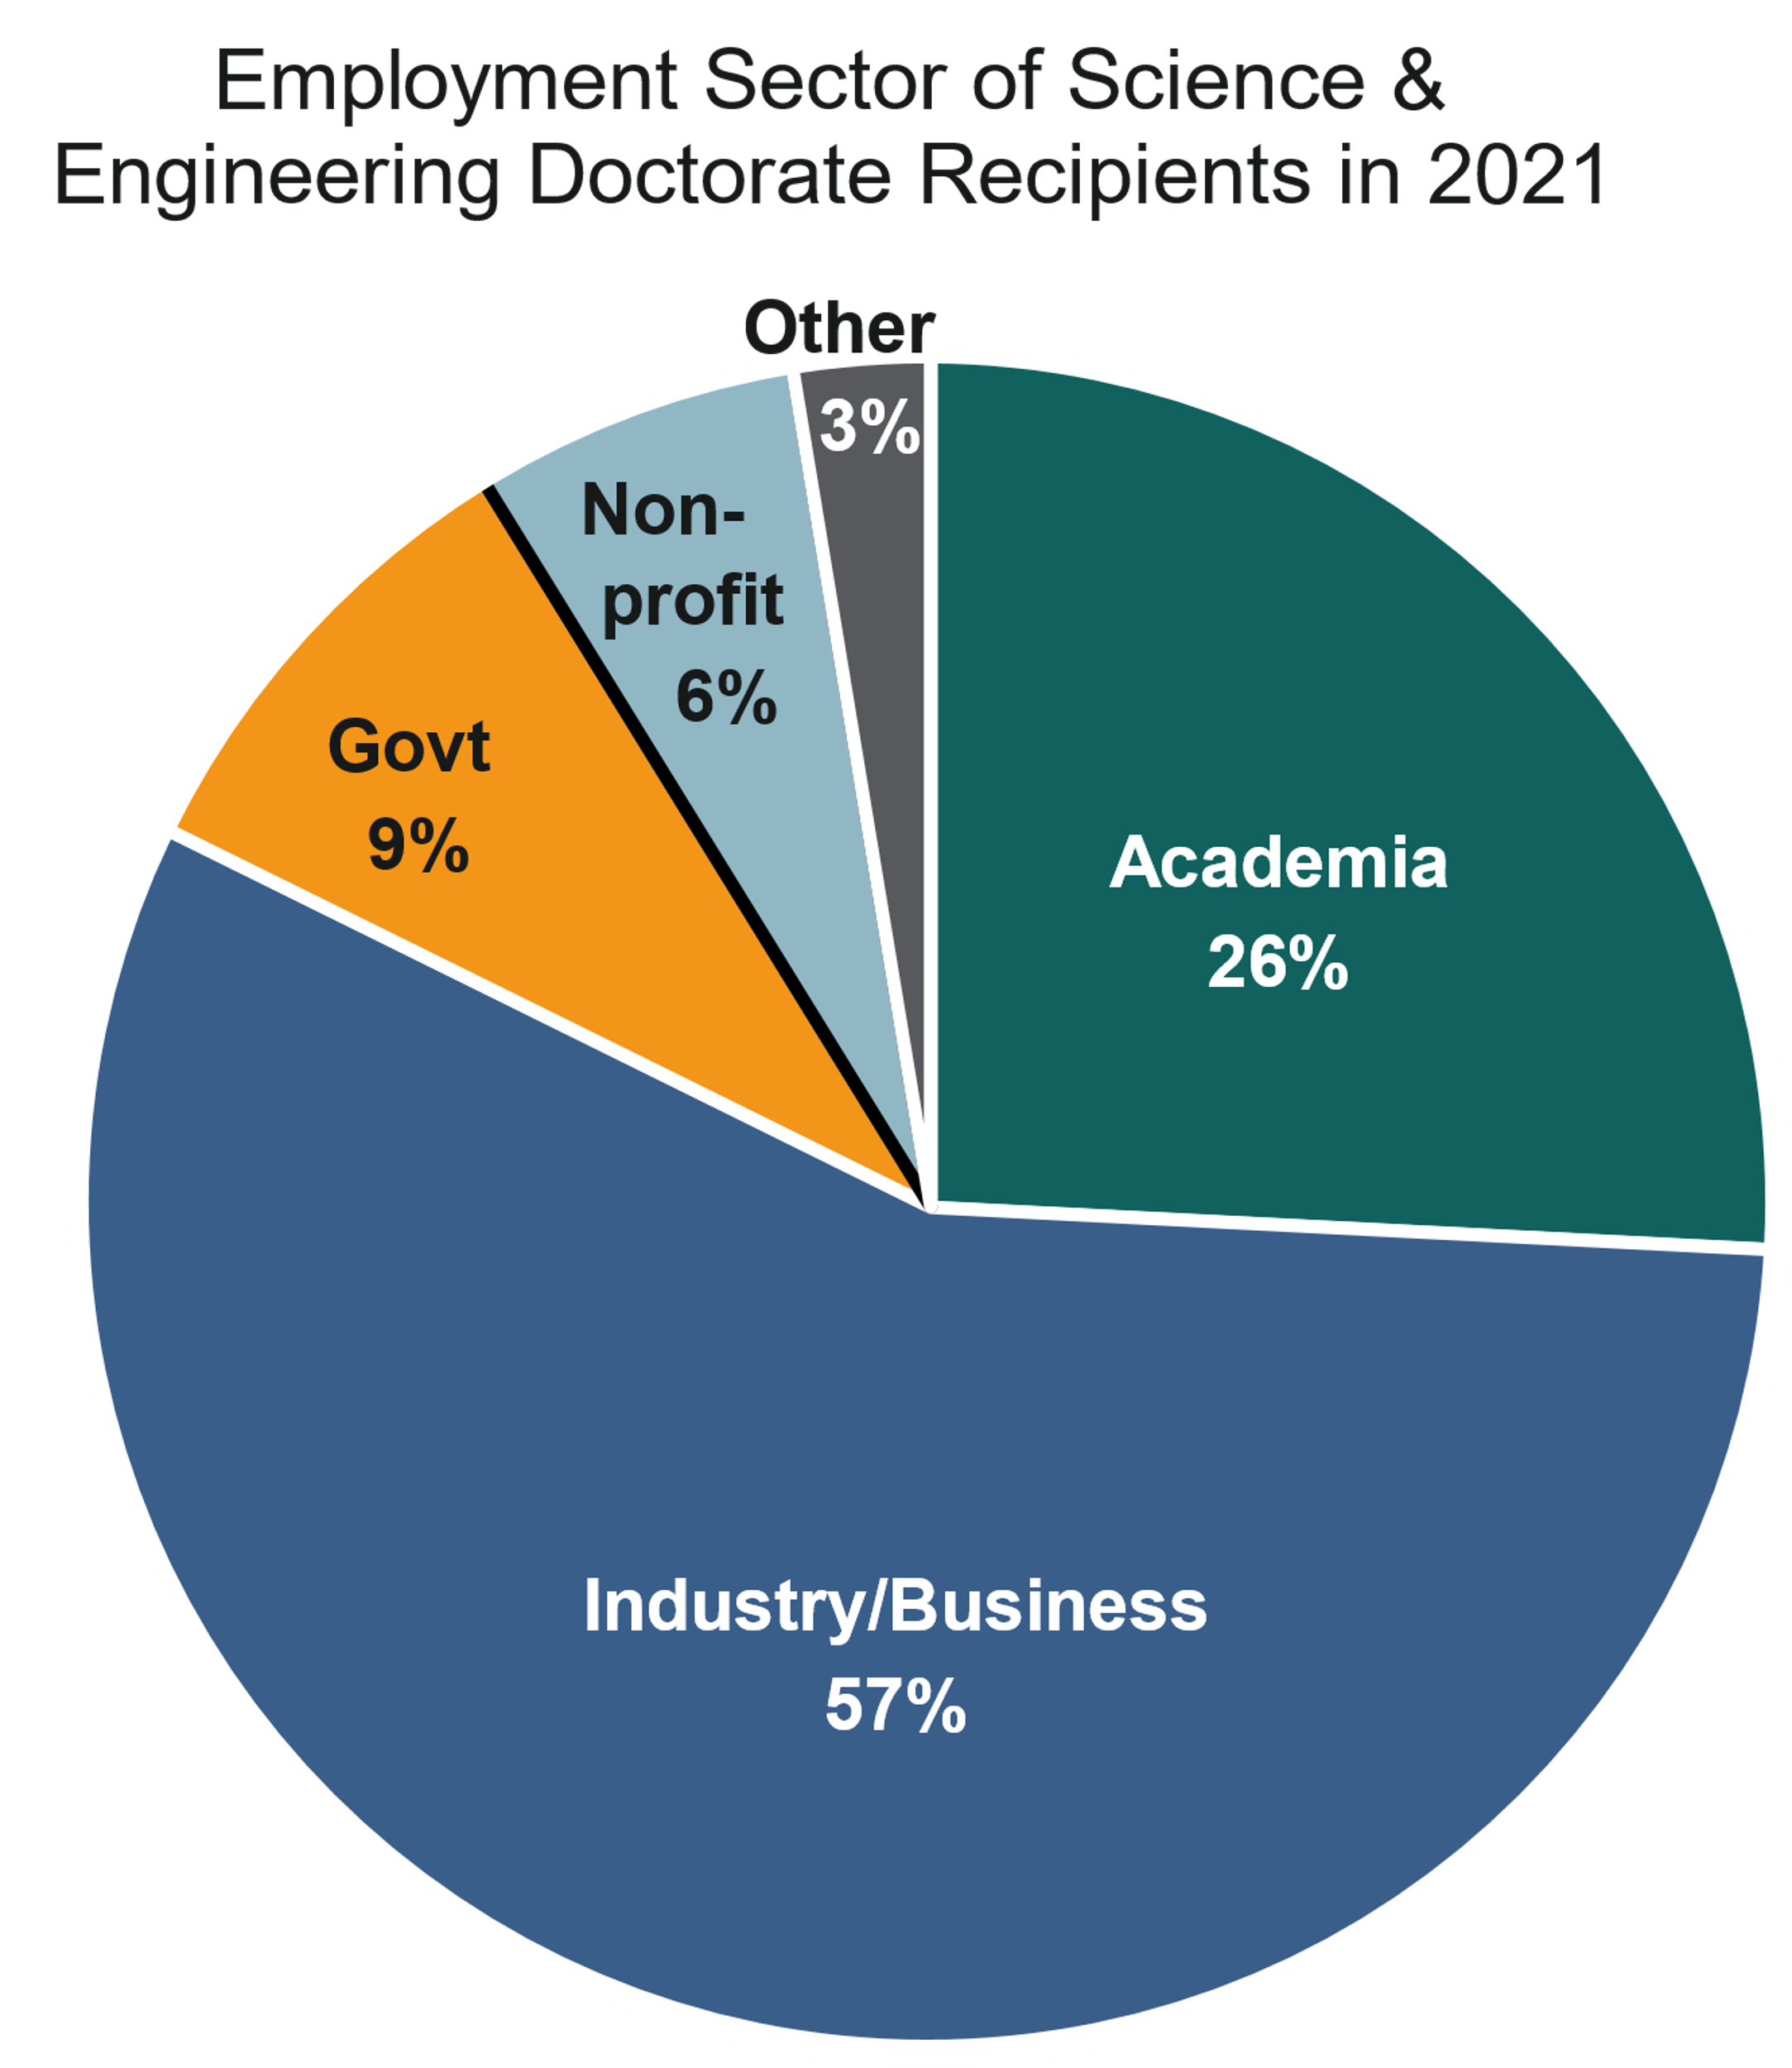
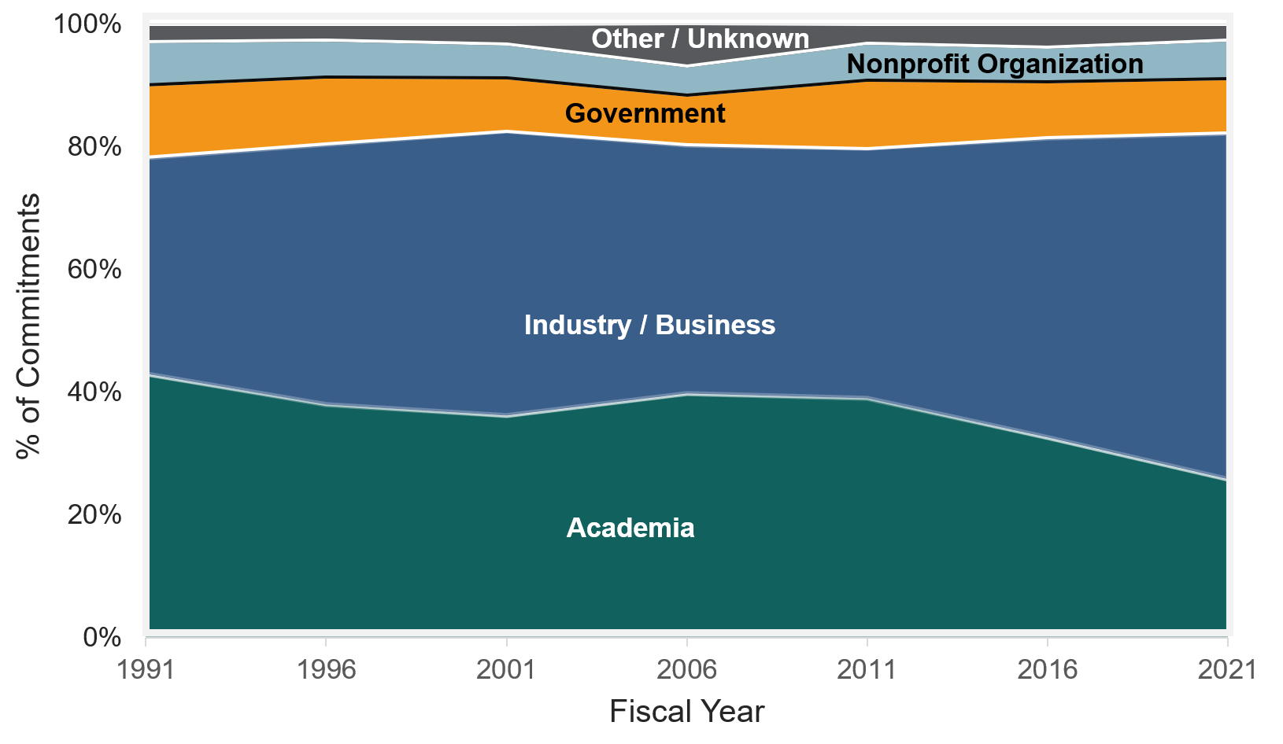
Increasing percentage of earned doctorates commit immediately to industry or business
Employment Sector of Science & Engineering Doctorate Recipients with Definite Postgraduation Commitments for U.S. Employment
Source: https://ncses.nsf.gov/pubs/nsf22319

Slide 4
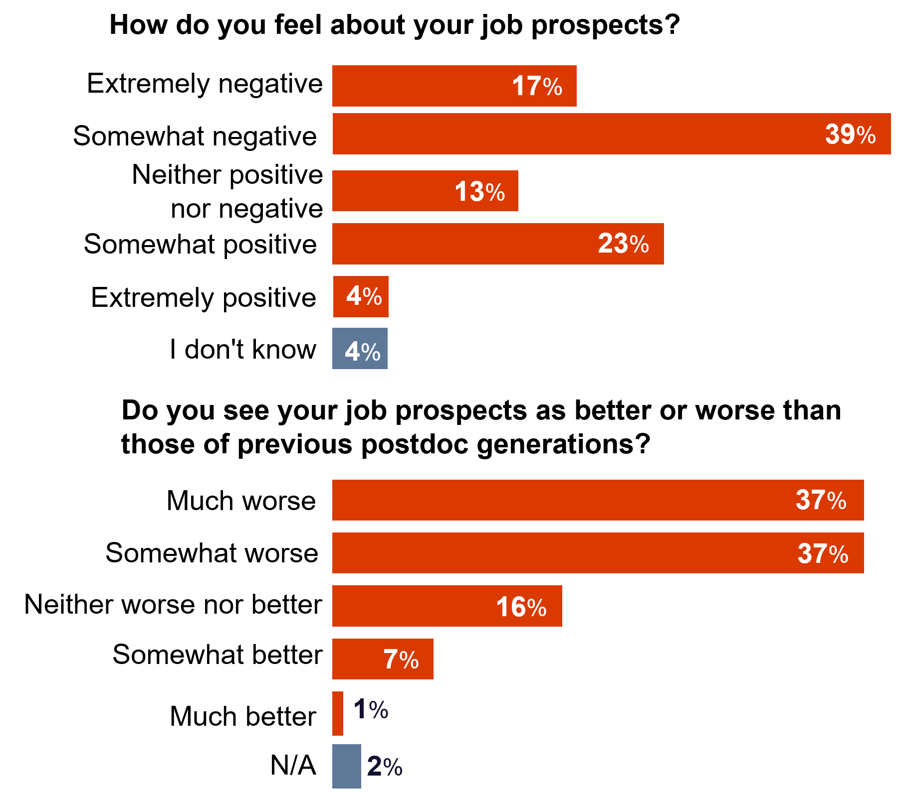
A majority of postdocs feel negative about their job prospects and see their prospects as worse than previous generations
Source: Woolston, Nature Career Feature 2020

Slide 5
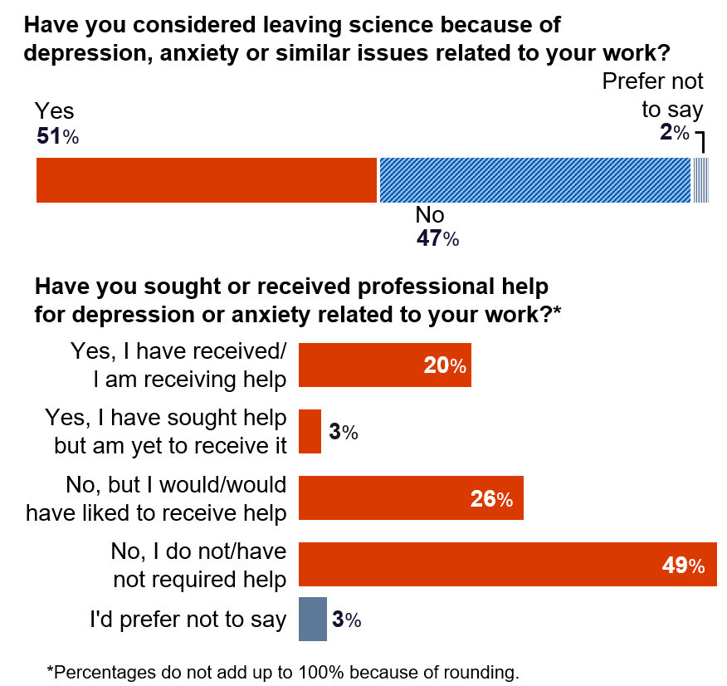
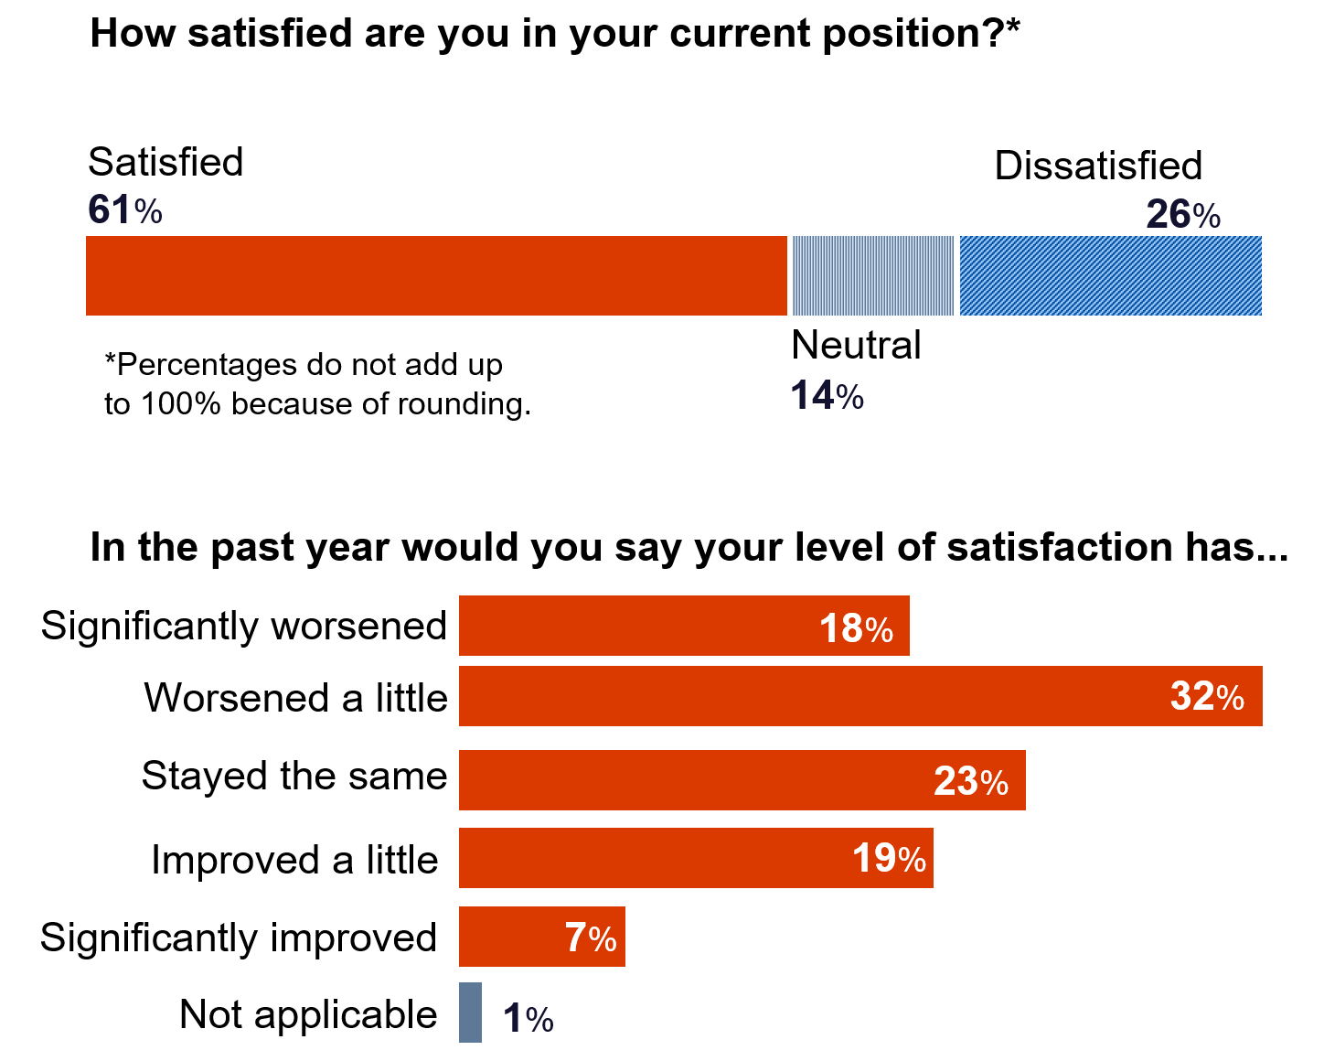
Postdoc satisfaction is decreasing, while more than half have considered leaving science due to mental health issues related to work
Source: Woolston, Nature Career Feature 2020

Slide 6
Today’s listening session: Job security, career prospects, and quality of life
Limited opportunities in academia
New opportunities in Pharma/Biotech
Increasing expectations: Work/life balance

